Slide 1

CSS
The make up for webpages

Slide 2
Positions
Static
Fixed
Relative
Absolute
Normal Flow of the document?

Slide 3
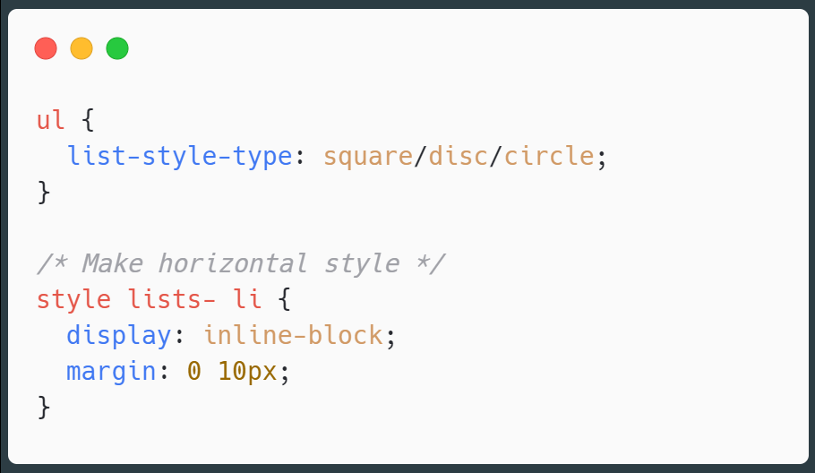
List Styling

Slide 4
CSS reset
https://gist.github.com/DavidWells/18e73022e723037a50d6

Slide 5
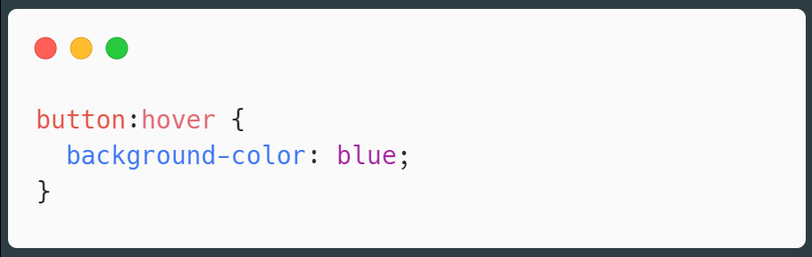
Pseudo Classes/Selectors
Pseudo classes are specified on selectors to specify a state or relation to the selector.

Slide 6
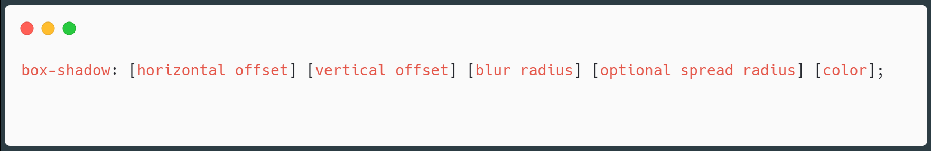
Box Shadow
The horizontal offset (required) of the shadow, positive means the shadow will be on the right of the box, a negative offset will put the shadow on the left of the box.
The vertical offset (required) of the shadow, a negative one means the box-shadow will be above the box, a positive one means the shadow will be below the box.
The blur radius (required), if set to 0 the shadow will be sharp, the higher the number, the more blurred it will be, and the further out the shadow will extend. For instance a shadow with 5px of horizontal offset that also has a 5px blur radius will be 10px of total shadow.
The spread radius (optional), positive values increase the size of the shadow, negative values decrease the size. Default is 0 (the shadow is same size as blur).
Color (required) – takes any color value, like hex, named, rgba or hsla. If the color value is omitted, box shadows are drawn in the foreground color (text color)

Slide 7
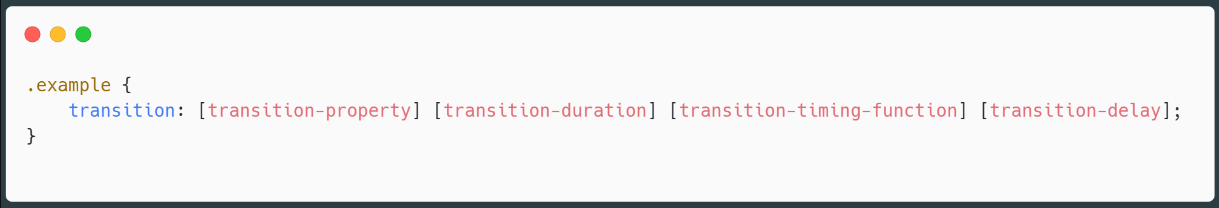
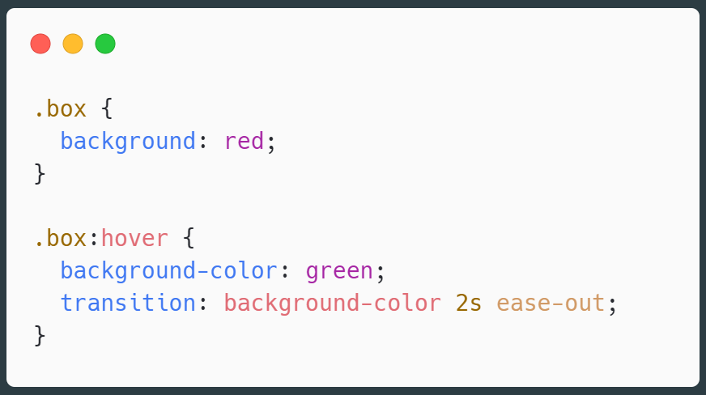
Transitions

Slide 8
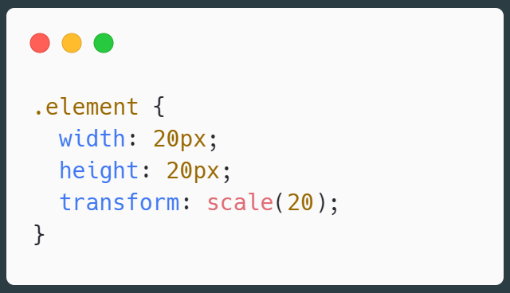
Transform
https://css-tricks.com/almanac/properties/t/transform/

